Slide 1
www.orchidproject.org
info@orchidproject.org

Slide 2
Agenda
What is FGC?
Where does FGC happen?
Impact of FGC on the lives of women and girls
Why is FGC practised and how can it end?
International efforts to end FGC
About Orchid Project and our grassroots partners
www.orchidproject.org

Slide 3
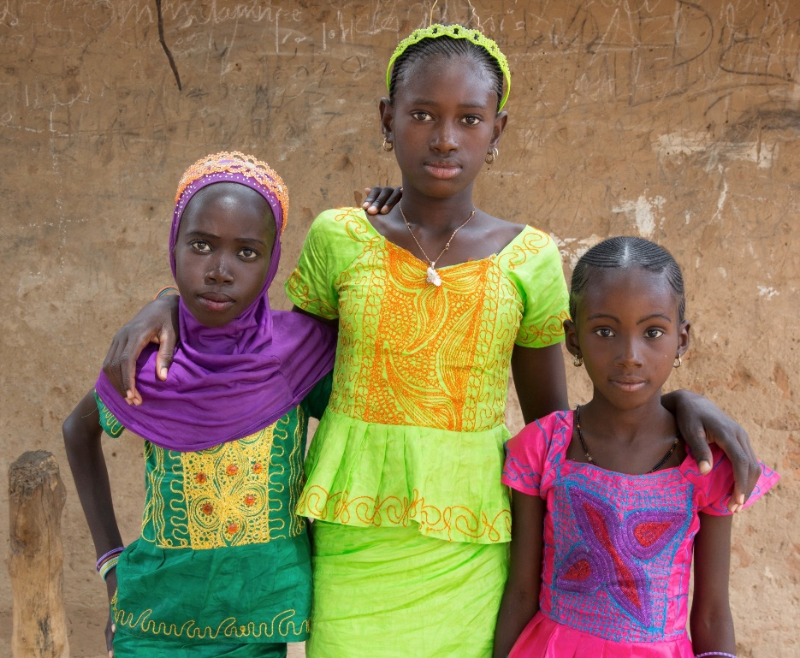
What is FGC?
FGC is the removal of a girl’s external genitals
No health benefits. Not endorsed by any religion
3.9 million girls at risk in the next 12 months
200 million women affected in at least 45 countries (only 30 countries report national data to UNICEF and UNFPA)
On average, girls are cut under the age of 5 years old
“All procedures that involve partial or total removal of the external female genitalia, or other injury to the female genital organs for non-medical reasons” - WHO
Sources: UNICEF and UNFPA 2018

Slide 4
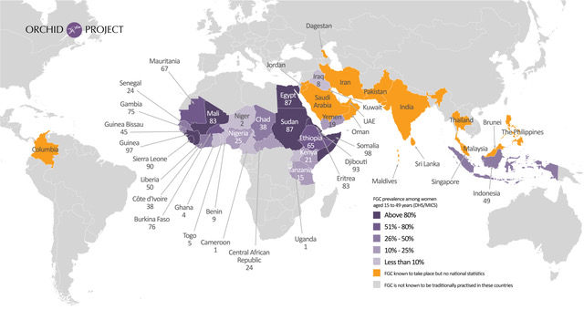
Notes:
This map illustrates where FGC takes place worldwide.
FGC is practised in 27 African countries, with the highest prevalence in countries such as Somalia, Sudan, Egypt and Mali.
FGC is also practiced in the Middle East - in countries such as Yemen, Iraq and Oman.
FGC is also practiced in Asia, including Indonesia (where 49% of girls have been cut), Malaysia and Thailand.
It is important to note that FGC is practised within ethnic groups and not necessarily universally in these countries. Severity also varies between groups.
It is practiced at all social classes and levels of education.
FGC is generally done by traditional practitioners however, in countries such as Egypt, 77% of FGC is performed by doctors and other health workers. In Indonesia, over 50% of FGC is performed by health workers. This is known as the medicalisation of FGC, However, the “medicalization” of FGC-which is wilful damage to healthy organs for non-therapeutic reasons – is unethical; the performance of FGC by a health professional is a violation of the ethical code governing health practice, which specifically requires that physicians, nurses and midwives “do not harm”.

Slide 5
Types of FGC (WHO classification)
Type I (Clitoridectomy)— Partial or total removal of the clitoris and/or the prepuce (clitoridectomy).
Type II (Excision) — Partial or total removal of the clitoris and/or the labia minora, with or without excision of the labia majora.
Type III (Infibulation) — Narrowing of the vaginal orifice with creation of a covering seal by cutting and appositioning the labia minora and/or the labia majora, with or without excision of the clitoris.
Type IV — All other harmful procedures to the female genitalia for non-medical purposes, for example: pricking, piercing, incising, scraping and cauterization.
Names for FGC around the world include: sunna, tahor, khatna, kisasa, female genital mutilation (FGM), female circumcision, cutting, excision.
www.orchidproject.org
Notes:
FGC is classified into 4 categories. Type 1-3 increase in severity.
Type 1 involves removal of the clitoris
Type 2 is removal of the clitoris and labia minora with or without excision of the labia majora
Type 3 is also known as infibulation where in addition to Type 2, the vaginal orifice is narrowed leaving a tiny hole to facilitate menstruation and urination. This hole can sometimes be the size of a matchstick head
Type 4 encompasses all other non-medical procedures such as piercing and scraping.
It is estimated that most cases are type 1, 2 and 4, with type 3 accounting for approximately 15% of all cases.
Please note that although slide A says ‘normal’ this is a subjective opinion and should really be called ‘uncut’ as what is ‘normal’ will vary. For communities that cut their girls, the other slides may be seen as normal.

Slide 6
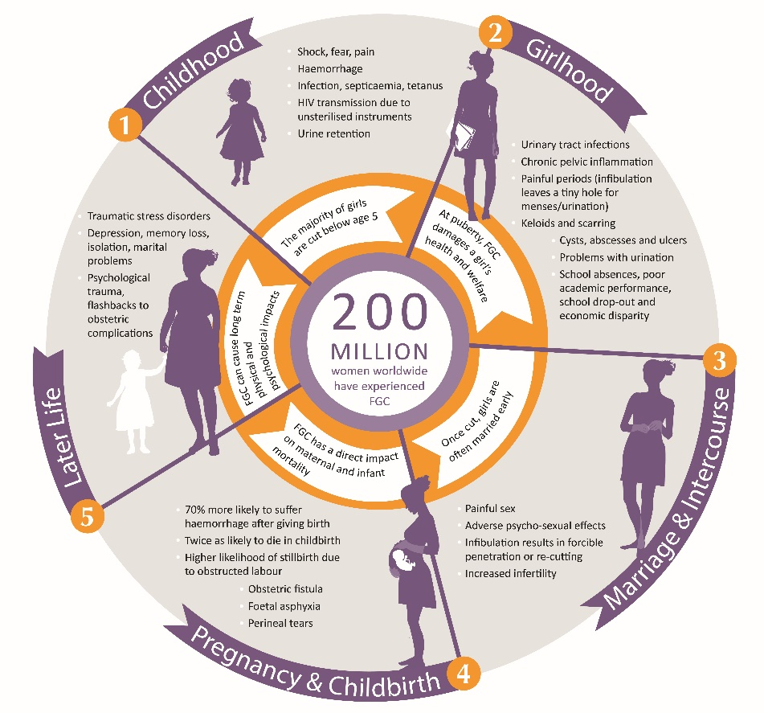
www.orchidproject.org
Notes:
The complications and their severity differ with type of FGC performed. Mention CM.
Immediate
Severe pain, fear and shock
Other lacerations in additional to the intended cuts, e.g. on the vagina, urethra, anus, thighs
Infection or anaemia
Haemorrhage – can lead to death
Within 10 days
Infections – tetanus, septicaemia, hepatitis
Urinary retention
Failure to infibulate – must be cut again
Pelvic infection
Menstruation
Period pain - menstrual blood cannot escape, stagnates and causes infection and inflammation
Recurrent UTIs
This slide is quite information laden but essentially the short term complications are: severe pain and shock, haemorrhage, sepsis, open genital sores, urine retention, HIV and Hep B infection and death.
Long term complications are: chronic pelvic inflammatory disease, subfertility, excessive scar tissue, complications in pregnancy/childbirth, sexual dysfunction, and psychological issues including PTSD. It can be next to impossible for a woman with Type 3 FGC to have sexual intercourse and it would be necessary to de-infibulate the woman on her wedding night. Her husband may need to forcibly penetrate her or she may need another cut, adding to the psychological and physical trauma.

Slide 7
Human rights
FGC contravenes:
• Universal Declaration of Human Rights (1948)
• Convention on the Rights of the Child (1989)
• Convention on the Elimination of All Forms of Discrimination against Women (CEDAW) (1979)
• African Charter on Human and Peoples’ Rights (Banjul Charter) including its Protocol on the Rights of Women (1998)
• African Charter on the Rights and Welfare of the Child (1999)
Female genital cutting is widely recognised as a violation of the human rights of girls and women
It also contravenes a number of international and regional treaties and conventions
FGC violates human rights principles of equality and non-discrimination on the basis of sex
The severe health consequences caused by FGC contravene the universal right to health
In some cases, FGC can lead to death, which affects the right to life
www.orchidproject.org

Slide 8
Why does FGC happen and how can it end?
Although FGC is a violation of human rights, families decide to cut their daughters for a wide variety of reasons including: misconception that FGC is religiously mandated; to preserve virginity/suppress female sexuality; beliefs around hygiene and cleanliness.
FGC is a social norm held in place by a whole community. It is difficult for one person or family to decide on their own to abandon the practice.
Orchid Project has seen that the most effective method of empowering communities to abandon FGC is through a holistic, human rights-led approach that includes non-judgmental, open dialogue.
www.orchidproject.org

Slide 9
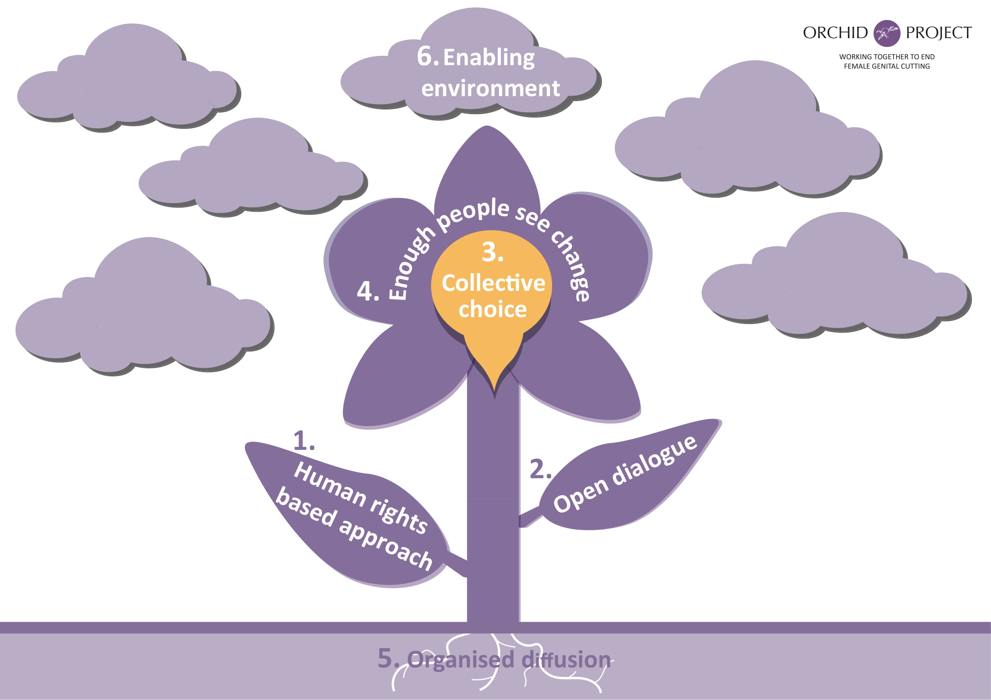
The 6 Elements of Abandonment
Source: UNICEF, 2007

Slide 10
International efforts to end FGC
UNICEF/UNFPA donors
Austria ◦ Iceland ◦ Ireland ◦ Italy ◦ Germany ◦ Luxembourg ◦ Norway ◦ Sweden ◦ Switzerland ◦ UK ◦ Private
UNICEF/UNFPA Joint Programme “Female Genital Mutilation/Cutting (FGM/C): Accelerating Change” (2008 – ongoing)
UK Dept. for International Development invested £35 million (2013)
UN General Assembly Resolution (2012 and 2014) to ban FGM/C worldwide
Sustainable Development Goals (2015) - under Goal 5 for Gender Equality lies:
Target 5.3 “to eliminate all harmful practices, such as child, early and forced marriage and female genital mutilations”
Indicator 41: “Percentage of girls and women aged 15-49 years who have undergone FGM/C
UN Sustainable Development Summit in 2016 - 193 nations agreed to new global target to end FGC by 2030
The latest UNICEF/UNFPA figures project that the current estimates of 3.9 million girls undergoing FGC each year will rise to 4.6 million by 2030, unless massively scaled-up efforts are taken urgently to prevent that from happening.
Notes:
FIAP - as a new commitment, FGC was mentioned for the first time;

Slide 11
About Orchid Project
Vision: A world free from female genital cutting
Mission: To foster and accelerate abandonment of FGC around the world
We achieve this by:
Advocating to ensure that stakeholders prioritise and resource an end to FGC
Sharing knowledge and the potential to end the practice within a generation
Partnering with organisations that deliver a sustainable, proven end to FGC
www.orchidproject.org

Slide 12
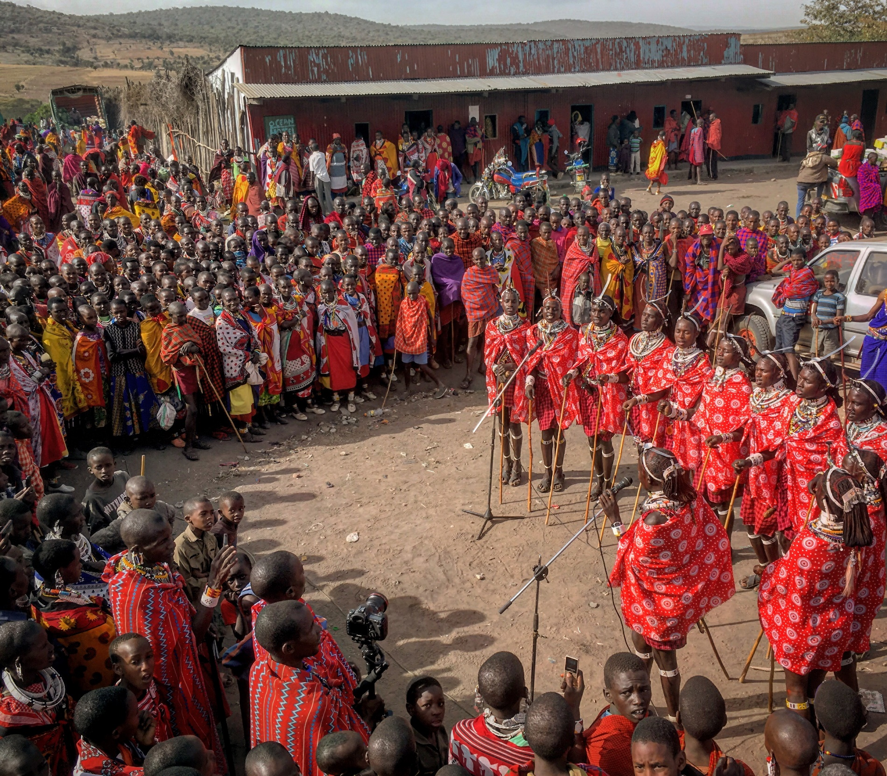
Young male Maasai “Morans” sing about FGC and human rights on an awareness raising performance tour around Loita Hills, South Kenya through work with our partner SAFE Maa.

Slide 13
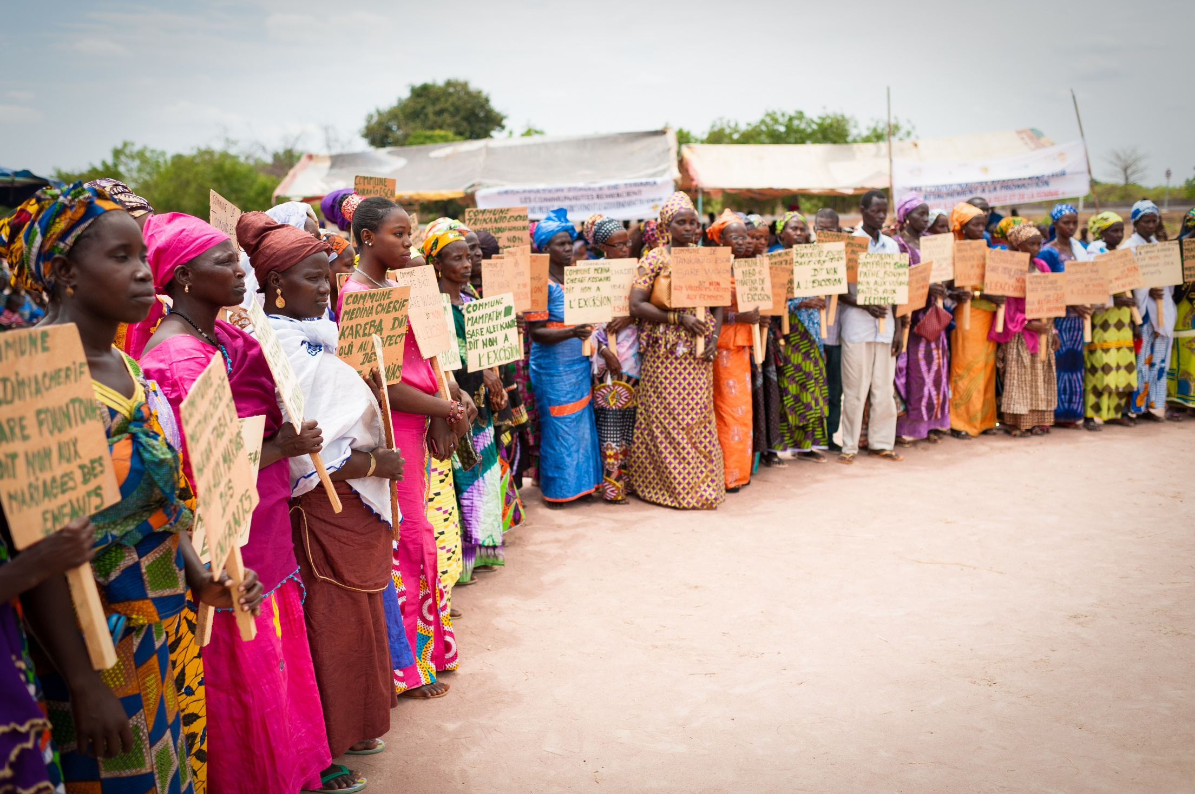
FGC abandonment declaration in Thiara, Kolda region of Southern Senegal through work with Orchid Project’s partner, Tostan.

Slide 14
Orchid Project Research
New baseline study into Kenyan attitudes towards FGC will be released by Orchid Project in the coming months.
Somaliland baseline research with ActionAid.
Somaliland baseline research with SOFHA, Population Council, Norad and Orchid Project.
Countries of opportunity: Kenya, Nigeria, Burkina Faso, Tanzania, Somalia.

Slide 15
Thank you
www.orchidproject.org

